Slide 1
Azure SQL Database: Not just a cloud version of SQL Server
HELLO
my name is
Bill Wilder
New England SQL Event
24-June-2016

Slide 2




CTO ➔

Slide 3
The Survey https://aka.ms/bosazureug

Slide 4
The Plan
High Level Comparison to SQL Server
Most Important Slide about the differences
Drill into random interesting capabilities
Securing
Some demos

Slide 5
Azure SQL is SQL Server Except…
Common
SQL Server
Azure SQL DB
“Just change the connection string…”
Innovation
Additional information on Differences:
https://azure.microsoft.com/en-us/documentation/articles/sql-database-transact-sql-information/
Notes:
http://www.sqlsaturday.com/71/Sessions/Details.aspx?oldsessionid=3792
Documentation example on SQL Always Encrypted Key rotation: https://msdn.microsoft.com/en-us/library/mt607048.aspx
Note that the documentions lists Azure SQL and SQL Server *together*

Slide 6
Demos
Demo: Create a SQL DB from PowerShell
Demo: Meet the Portal (portal.azure.com)
Demo: Create a SQL DB from portal
Demo: (LATER) Delete all demo resources at once
Notes:
ClaimsPrincipal.Current.Identity.Name
ClaimsPrincipal.Current.Claims.ToArray()

Slide 7
What’s the Same
Single Team – Cloud First
Core Code Base
Transact-SQL
Yes, full support
https://feedback.azure.com/
Most of the features
Mature

Slide 8
What’s Missing (or is it?)
Category 1: Takes a Different Approach
Example: SQL Agent
Category 2: On the way
Network Support
But in the works…
Category 3: No plan (?)
https://feedback.azure.com/

Slide 9
CORE Intentional Differences
Most Important Slide
Azure SQL Database
SQL Server
Control Plane (ARM, API, Scripting, Portal)
Storage ecosystem
Limited vertical scale
1 TB
License (pay) by hour
Manageability over control
Installed/locked up
“The database”
Unlimited*
*Available hardware (16 TB VM?)
Box License (or VM)
Control over manageability
Notes:
https://azure.microsoft.com/en-us/documentation/articles/virtual-machines-linux-sizes/
Standard_G5 = 32 cores + 448 GiB RAM + VMs support up to 16 TB of disk

Slide 10
ARM: Azure Resource Manager
Resource Groups
ARM Templates
Model based + imperative
Your DB can live with other resources, spanning regions
DB in exactly 1 RG, but there’s a linking mechanism
Lifecycle, monitoring, admin access
http://armviz.io/#/
https://github.com/Azure/azure-quickstart-templates
https://portal.azure.com/

Slide 11
“Bring Your Own” ____ as a Service
BYO Users
BYO Applications
BYO Virtual Machines
SaaS➔
PaaS➔
IaaS➔

Slide 12
Public ⬄ Hybrid ⬄ Private
 | Public Cloud Data Center | Your Company Data Center
Public Cloud
Hybrid Cloud
Private Cloud

Slide 13
Connection String
Securing SQL
Tools for access
Performance
DMV
Other data stores
Reporting
Compliance
https://azure.microsoft.com/en-us/campaigns/azure-vs-aws/mapping/
Resource Groups & DevOps
Tools to access
Backup, restore, ….
DTU
Reporting
Data warehouse
Stream Analytics
https://azure.microsoft.com/en-us/status/#history

Slide 14
Manageability
Server Management so easy - not available!
You control schema, indexes, users, etc. as usual
PaaS model
99.95% uptime SLA (one instance)
Geo-DR/FO/BC (Active/Passive)
Geo-Replication (Active/Active RO)
Backups, PiTR
ARM

Slide 15
Data Platform Ecosystem
Data Lakes, Pooled SQL Instances
Elastic database tools
Data Warehouse
Hadoop Connector
Blob Storage – files
Table Storage, DocumentDB - NoSQL
Third Party Storage Solutions (e.g., Mongo)

Slide 16
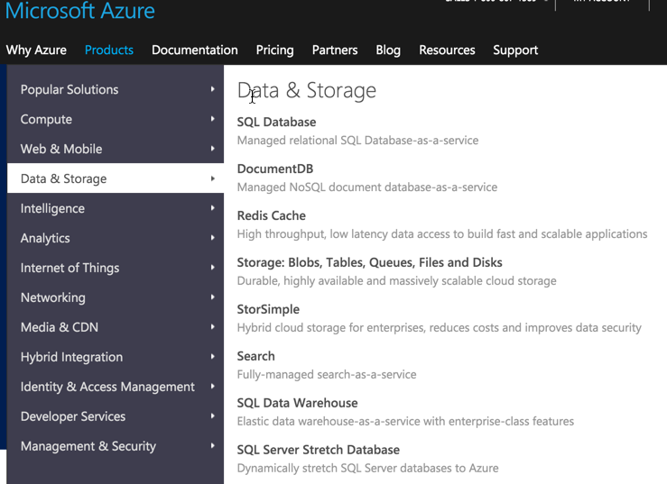
Azure Data & Storage Services
https://azure.microsoft.com/en-us/services/#

Slide 17
DMV Views DTU eDTU
Performance

Slide 18
SQL Azure DMV views
https://azure.microsoft.com/en-us/documentation/articles/sql-database-monitoring-with-dmvs/
Notes:
https://azure.microsoft.com/en-us/documentation/articles/sql-database-monitoring-with-dmvs/

Slide 19
Data Throughput Unit
http://dtucalculator.azurewebsites.net/
Demo: DTU definition https://azure.microsoft.com/en-us/documentation/articles/sql-database-service-tiers/#understanding-dtus

Slide 20
SQL Pools Geo Repl
Pricing

Slide 21
Pricing in Tiers and Pools
Demo: Pricing options https://azure.microsoft.com/en-us/pricing/
https://azure.microsoft.com/en-us/documentation/articles/sql-database-service-tiers/

Slide 22
the HARRENHAL fortress
http://gameofthrones.wikia.com/wiki/Harrenhal?file=Harrenhal.jpg
Harrenhal
Threats Change Over Time
"The largest and greatest fortress ever built in Westeros..
Harren thought the walls of his massive castle could withstand any assault, but he did not realize that dragons could simply fly over them.”
http://gameofthrones.wikia.com/wiki/Harrenhal
Threat models CHANGE over time!
http://gameofthrones.wikia.com/wiki/Harrenhal?file=Harrenhal.jpg
Threats Change Over Time
Notes:
"The largest and greatest fortress ever built in Westeros..
Harren thought the walls of his massive castle could withstand any assault, but he did not realize that dragons could simply fly over them.”
http://gameofthrones.wikia.com/wiki/Harrenhal
http://gameofthrones.wikia.com/wiki/Harrenhal?file=Harrenhal.jpg
Threats Change Over Time
The architecture of Harrenhal did not anticipate a world where they would need to defend airborne attack from fire-breathing dragons.
The architecture of most legacy enterprise infrastructure did not anticipate a world where there is no longer a security perimeter.
Architect is fundamental. Hard to change.

Slide 23
Securing SQL Azure
“[Cloud security] is a shared responsibility between the customer and the cloud vendor.”
Mark Russinovich, Microsoft Azure CTO
https://www.rsaconference.com/writable/presentations/file_upload/exp-w01_assume-breach-an-inside-look-at-cloud-service-provider-security.pdf
Notes:
Cloud Spaces; Dropbox; Top Azure Risks; Shadow IT; Cloud Outages

Slide 24
A Cautionary Tale: Code SpaceS
DDoS
Ransom demand
Security breach noticed
Fighting back
Malicious destruction of assets
Security & Business #fail
https://aws.amazon.com/iam/details/mfa/
ELAPSED TIME: 12 HOURS
“Code Spaces has a full recovery plan that has been proven to work and is, in fact, practiced.”
Data plane (data access) vs. mgmt/control plane (Portal, APIs, PowerShell)
http://arstechnica.com/security/2014/06/aws-console-breach-leads-to-demise-of-service-with-proven-backup-plan/

Slide 25
Top Azure Risks Leading to Tenant Breach
(Slide from Mark Russinovich’s talk at RSA 2015)
Risk | Mitigation
Internet Exposed RDP or SSH Endpoints | Network ACLs or Host-based Firewall; Strong passwords; VPN or SSH Tunnels
Virtual Machine Missing Security Patches | Keep Automatic Updates Enabled;
Web Application Vulnerability | Securing Azure Web Applications; Vulnerability scan/penetration test
Weak Admin/Co-Admin Credentials | Azure Multi-Factor Authentication; Subscription Management Certificate
Unrestricted SQL Endpoint | Azure SQL Firewall
Storage Key Disclosure | Manage Access to Storage Resources
Insufficient Security Monitoring | Azure Security and Log Management;
https://www.rsaconference.com/writable/presentations/file_upload/exp-w01_assume-breach-an-inside-look-at-cloud-service-provider-security.pdf
Notes:
Cloud is not magic – but it can help A LOT
iCloud, Dropbox, encryption, MFA, …
ShellShock help

Slide 26
SSO for Built-In Services
Use same AAD where makes sense across
Azure
Office 365
Visual Studio Team Services
Windows 10 (Intune)
Azure SQL Database (!)

Slide 27
Prefer RBAC to Co-Admin
Co-Admin only option on Classic Portal
RBAC only available on portal.azure.com
New portal support not 100%
Demo: Add a Reader to Azure SQL DB Server
Resources:
https://azure.microsoft.com/en-us/documentation/articles/role-based-access-built-in-roles/
https://azure.microsoft.com/en-us/documentation/articles/role-based-access-control-configure/
Notes:
Manage MEMBERSHIP within AAD
http://dev-esign2.azurewebsites.net/

Slide 28
ONGOING Investment in Security
Research & Development – “Microsoft invests >$1B dollars in security R&D, every year.” –Satya Nadella, CEO, Microsoft
Microsoft Acquisitions – Adallom, Aorato, others
http://blogs.microsoft.com/blog/2015/11/17/enterprise-security-for-our-mobile-first-cloud-first-world/
Notes:
“Microsoft invests more than a billion dollars in security research and development, every year.” http://blogs.microsoft.com/blog/2015/11/17/enterprise-security-for-our-mobile-first-cloud-first-world/
https://azure.microsoft.com/en-us/documentation/videos/red-vs-blue-internal-security-penetration-testing-of-microsoft-azure/
“Azure Active Directory and Office 365, automatically detect when a user may have been compromised” https://www.rsaconference.com/writable/presentations/file_upload/exp-w01_assume-breach-an-inside-look-at-cloud-service-provider-security.pdf

Slide 29
MFA RBAC Subscription as Security Container
Protecting the Management/Control Plane

Slide 30
Multi-Factor Authentication (MFA/2FA)
Demo: MFA: https://account.activedirectory.windowsazure.com/UserManagement/MultifactorVerification.aspx
Demo: App Passwords: https://account.activedirectory.windowsazure.com/UserManagement/MfaSettings.aspx
Demo: App Password Configuration: https://account.activedirectory.windowsazure.com/AppPasswords.aspx

Slide 31
A Brief History of Azure Portals
v1: HTML
v2: Silverlight
v3: back to HTML
Today known as “classic” portal
https://manage.windowsazure.com
v4: back to Silverlight
(Just kidding) really HTML 5
More granular security: RBAC
https://portal.azure.com
http://arstechnica.com/security/2014/06/aws-console-breach-leads-to-demise-of-service-with-proven-backup-plan/

Slide 32
Portal PowerShell SDKs (C#)
Managing the Control Plane
Notes:
https://blogs.msdn.microsoft.com/sqlsecurity/2015/05/12/recommendations-for-using-cell-level-encryption-in-azure-sql-database/

Slide 33
nesting
Azure Account contains…
Azure Subscription contains…
Azure Resource Group contains…
SQL Database Server contains…
Logical construct
Anchored in single region
But RG can span many resources, many regions
SQL Database
Physical construct

Slide 34
Always Encrypted TDE Data Masking Auditing Firewall
Protecting Your
SQL Database
Notes:
https://blogs.msdn.microsoft.com/sqlsecurity/2015/05/12/recommendations-for-using-cell-level-encryption-in-azure-sql-database/

Slide 35
Scope and Depth (and Partners)
Azure Security Center is a Service – “Azure Security Center, now in private preview, works with companies like Barracuda, Checkpoint, Cisco Systems Inc., CloudFlare, F5 Networks, Fortinet, Imperva, Incapsula, and Trend Micro Inc. to offer advanced, analytics-driven threat detection that helps you protect, detect and respond to security threats in real-time.”
Alert: “VM X and DB Y are not secure”
Alert: “Asset Z has been compromised”
http://blogs.microsoft.com/blog/2015/11/17/enterprise-security-for-our-mobile-first-cloud-first-world/
Notes:
Services are UPDATED ALL THE TIME w/o you having to do anything

Slide 36
Demos
Demo: RBAC Permissions
Demo: Azure Security Center
Demo: Delete a Resource Group
Notes:
ClaimsPrincipal.Current.Identity.Name
ClaimsPrincipal.Current.Claims.ToArray()

Slide 37
*NEW* *The* place to go for Azure Security resources
https://azure.microsoft.com/en-us/documentation/security/#

Slide 38
Firewalls
Demo: SQL DB Server
Database Level: sp_set_firewall_rule

Slide 39
Data Masking
Dynamic Data Masking: https://azure.microsoft.com/en-us/documentation/articles/sql-database-dynamic-data-masking-get-started/
Server-side

Slide 40
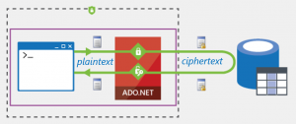
SQL DB Data Encryption Always Encrypted
Demo: Transparent Data Encryption
Server-side
Always Encrypted: https://azure.microsoft.com/en-us/updates/public-preview-always-encrypted-for-azure-sql-database/
Client-side
Notes:
Key rotation: https://msdn.microsoft.com/en-us/library/mt607048.aspx
Note that the documentions lists Azure SQL and SQL Server *together*

Slide 41
TDE AKV DocUMENTS
Blob Storage & Azure Key Vault

Slide 42
Valet Key Pattern HTTPS, CORS
More Blob Storage & Azure Key Vault

Slide 43
GEO-REPL PITR
Disaster Recovery and Business Continuity

Slide 44
https://portal.azure.com/#blade/Microsoft_Azure_Security/SecurityMenuBlade/0

Slide 45
Compliance (wow!) Court Battle Avoiding Future Court Battle
Privacy & Compliance

Slide 46
Compliance & Privacy
Compliance
Privacy
Security vs. Compliance
Microsoft, Azure, Azure Government strong compliance story
https://www.microsoft.com/en-us/TrustCenter/Compliance/
Dublin Email Microsoft (+10 amicus briefs) fighting a US Gov’t SCA extra-territorial subpoena for customer email data in Dublin (since 2013)
Data Trustee Model “German data trustee, Deutsche Telekom, will control and oversee all access to customer data” for Microsoft
https://news.microsoft.com/europe/2015/11/11/45283/
Notes:
Encryption *between* data centers since Snowden
FBI vs. Apple (San Bernadino)
http://blogs.microsoft.com/on-the-issues/2016/03/03/our-legal-brief-in-support-of-apple/
http://www.csmonitor.com/World/Passcode/2014/1216/How-Microsoft-s-battle-with-the-Justice-Department-could-reshape-privacy-laws-video, http://business.financialpost.com/fp-tech-desk/as-microsoft-takes-on-the-feds-in-privacy-fight-apple-and-amazon-watch-nervously, http://www.theguardian.com/technology/2014/dec/14/privacy-is-not-dead-microsoft-lawyer-brad-smith-us-government, http://www.irishtimes.com/business/microsoft-warns-of-risks-to-irish-operation-in-us-search-warrant-case-1.2548718
By Brad Smith: http://www.wsj.com/articles/brad-smith-were-fighting-the-feds-over-your-email-1406674616

Slide 47
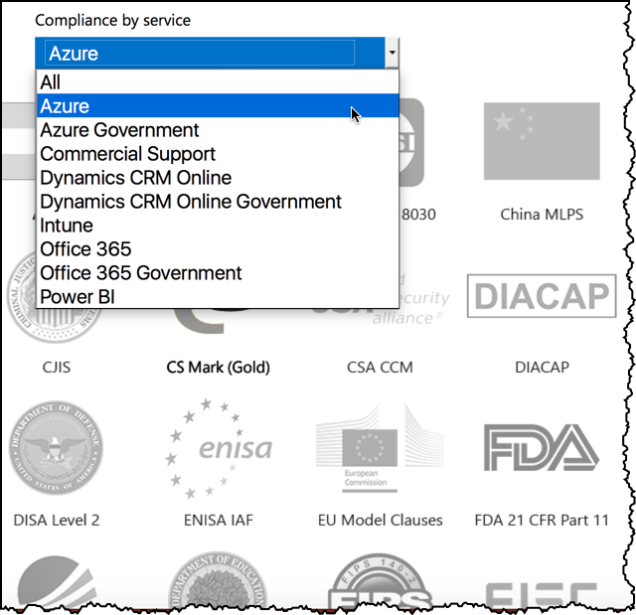

Slide 48
Scope and Depth (and Partners)
Azure Security Center Service – “Azure Security Center, now in private preview, works with companies like Barracuda, Checkpoint, Cisco Systems Inc., CloudFlare, F5 Networks, Fortinet, Imperva, Incapsula, and Trend Micro Inc. to offer advanced, analytics-driven threat detection that helps you protect, detect and respond to security threats in real-time.”
Alert: “VM X and DB Y are not secure”
Alert: “Asset Z has been compromised”
http://blogs.microsoft.com/blog/2015/11/17/enterprise-security-for-our-mobile-first-cloud-first-world/
Notes:
Services are UPDATED ALL THE TIME w/o you having to do anything

Slide 49
Retail EA BizSpark, DreamSpark MSDN Account Free Trial http://aka.ms/iaas
Where’s My Azure?

Slide 50
Demos
Demo: (as mentioned earlier) Delete all demo resources at once

Slide 51

Notes:
Subliminal ☺ … 0.25

Slide 52

Questions?
Find this slide deck here
See you at Boston Azure
bostonazure.org
Bill Wilder @codingoutloud
codingoutloud@gmail.com
blog.codingoutloud.com
linkedin.com/in/billwilder

